Slide 1

$15 and for 2 for only $30!
Signed copies get $1 off.

Slide 2
Thanks CIU
Margo Williams
David Chasin
All the others whom I don’t know by name, or probably just forgot their names, forgive me for that.

Slide 3
Disclaimer
Rev. Vernon Johns the predecessor of Rev. Dr. Martin Luther King Jr. is quoted as saying;
  ‘If you see a good fight, get in it!’
  So I can say ‘Lord they started it!’

Slide 4
Disclaimer
The opinions expressed here stay here
  Not represent anyone but…,
    Don’t blame my mama, my wife, pastor, friends, mission agency…,
    Pauline disclaimer…, don’t even blame Jesus, ‘cuz I don’t want Him coming after me on some of this!
      1Co 7:12 But to the rest speak I, not the Lord..’

Slide 5
Missions is the Ministry of the Maladjusted
In an essay ‘A knock at midnight’, Dr. King writes thusly: Modern psychology has a word that is probably used more than any other word. It is the word “maladjusted.”
Now we should all seek to live a well adjusted life in order to avoid neurotic and schizophrenic personalities.
But there are some things within our social order to which I am proud to be maladjusted and to which I call upon you to be maladjusted…., I call upon you to be as maladjusted as Amos who in the midst of the injustices of his day cried out in words that echo across the generation,
“Let judgment run down like waters and righteousness like a mighty stream…”

Slide 6
Missions is the Ministry of the Maladjusted
Out of step…, walking with Jesus (Galatians 5:16)
Out to lunch.., the mind of Christ (Philippians 2:5)
Out of touch.., see things that aren’t (Hebrews 11:3)
Out of order…, not fit for this world (Hebrews 11:38)
Out of style…,not conformed (Romans 12:2)
Out yo’.., cotton pickin’ mind! (Minnie A. Negro)

Slide 7

Genesis 1:2 And the earth was without form, and void; and darkness was upon the face of the deep. And the Spirit of God moved upon the face of the waters.

Slide 8

God was happy…,
Genesis 1:31 And God saw every thing that he had made, and, behold, it was very good. And the evening and the morning were the sixth day.

Slide 9
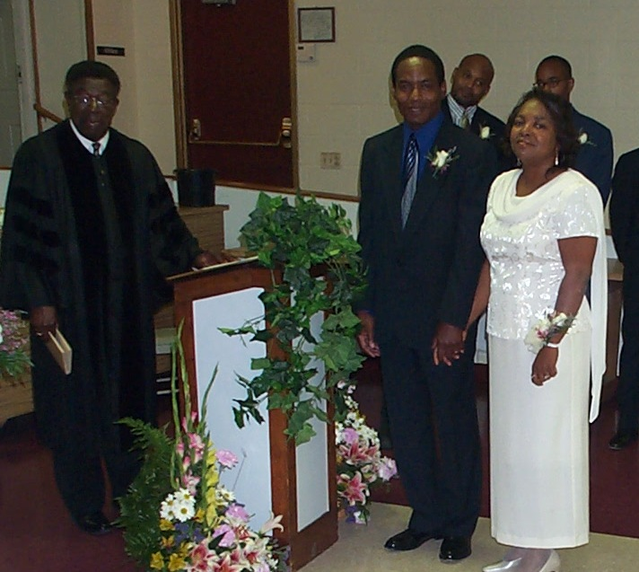
God was very happy!
I was delighted too!
Genesis 2:22 And the rib, which the LORD God had taken from man, made he a woman, and brought her unto the man.

Slide 10
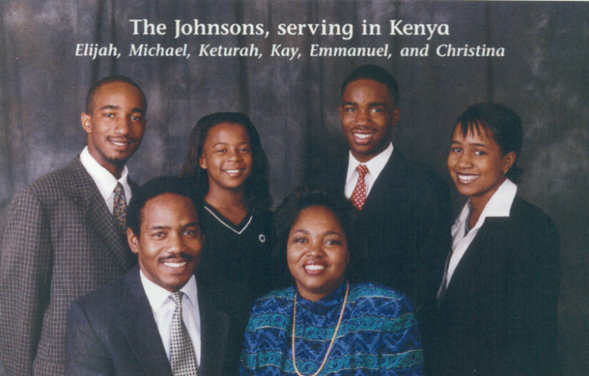
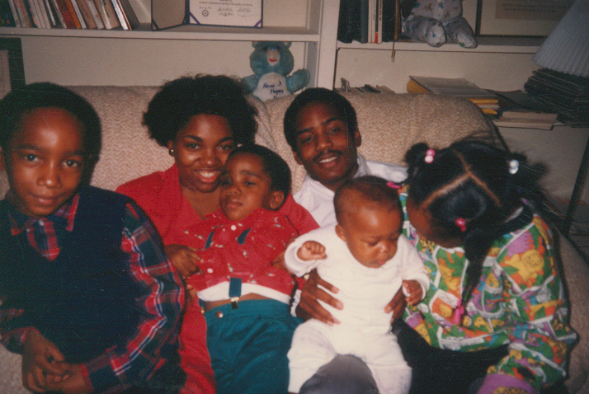

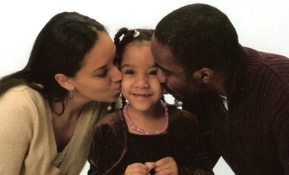
Be Fruitful and Multiply

Slide 11
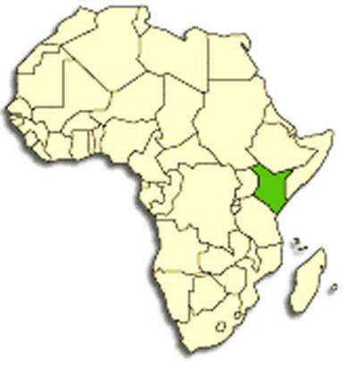

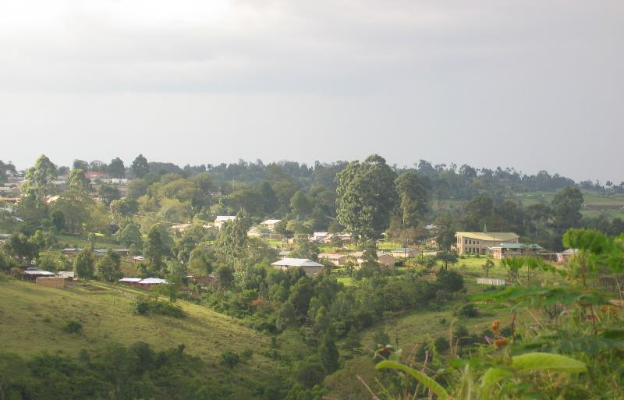
A Big Move!
1989 Philadelphia to Bomet, Kenya

Slide 12
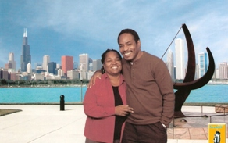

“Green Acres is the place to be?!?”
Despite advice from the old sage Minnie A.

Slide 13
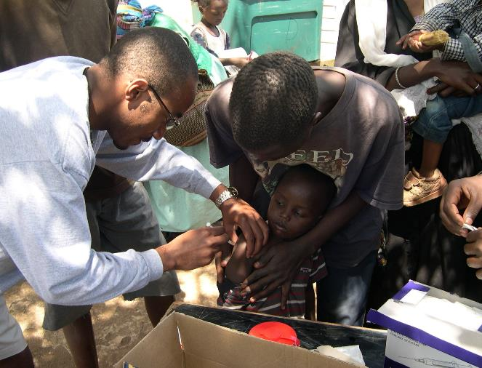
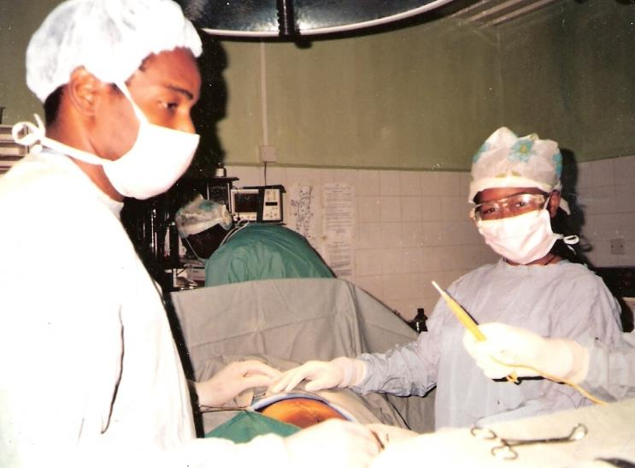
Surgery and medicine in the tropics
Immunizations in the city slums.
Surgery in small towns!

Slide 14
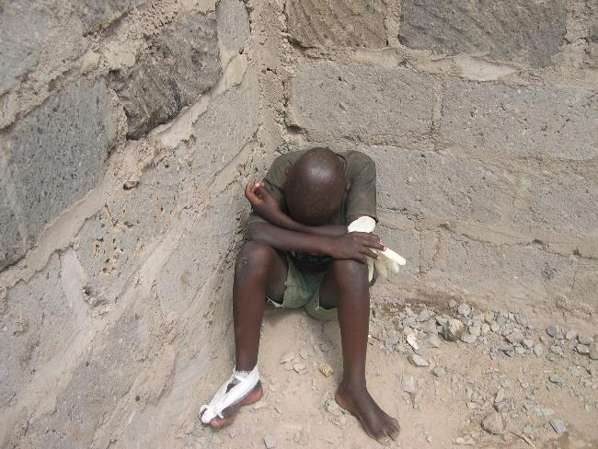
We saw children in pain, communities without food and water.
God is not happy, children cry…,
and all creation moans

Slide 15
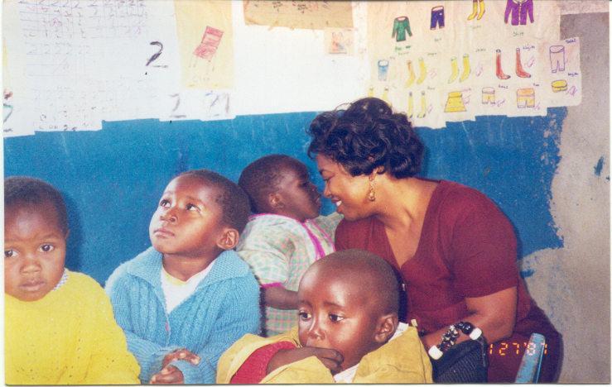

We provided for some of the tens of thousands of orphans (mostly from HIV AIDS).
There are at least 1.6-1.8 million orphans in Kenya and 20 million in
Sub-Saharan Africa, mostly from AIDS.

Slide 16
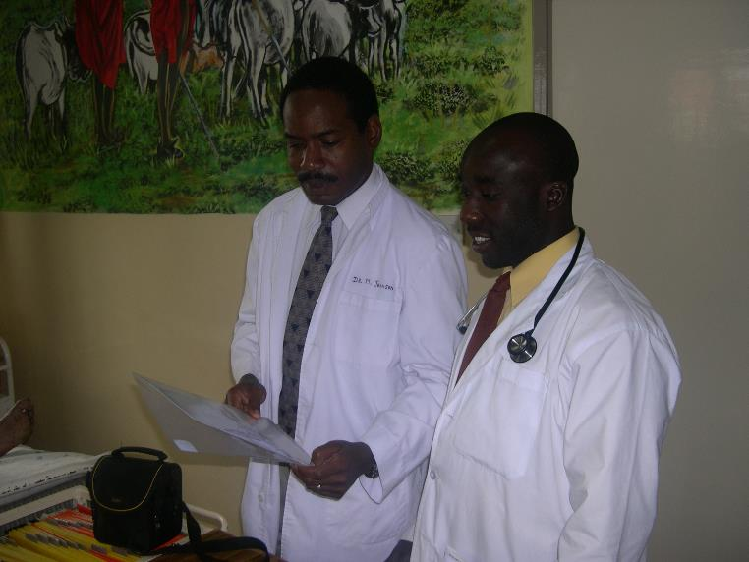

We started training Kenyan physicians in Kenya.
There are a total of 5,000 physicians (1 to every 70,000 people versus
1 to 450 people in the US).
Africa today has the lowest ratio of health and education personnel
to population in the world. (World Development Report, 1993, World Bank.)

Slide 17
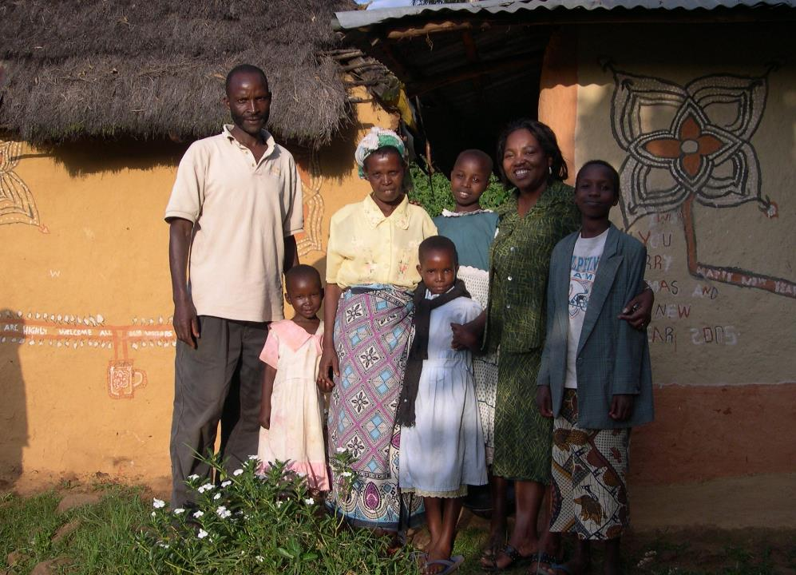
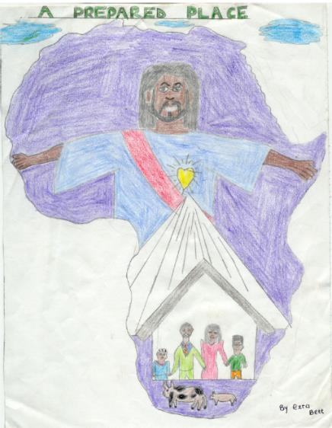
Giving children another option than orphanages or sleeping on streets.

Slide 18
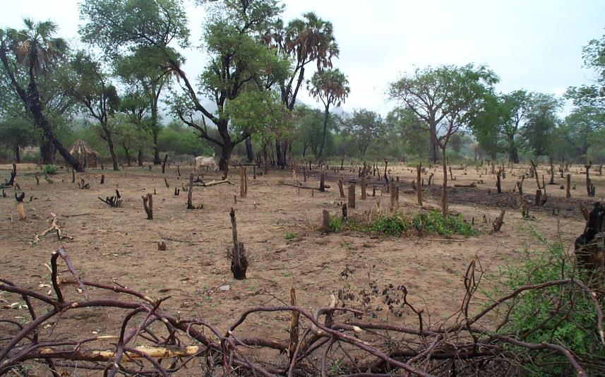
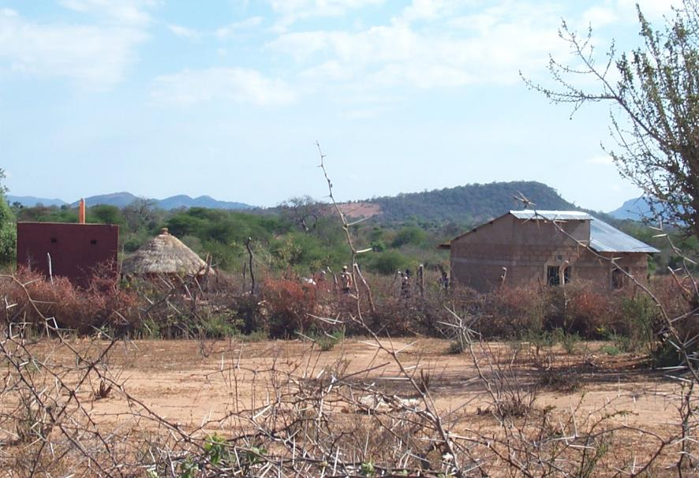
We saw barren lands so…

Slide 19


we became farmers…put in pumps,

Slide 20
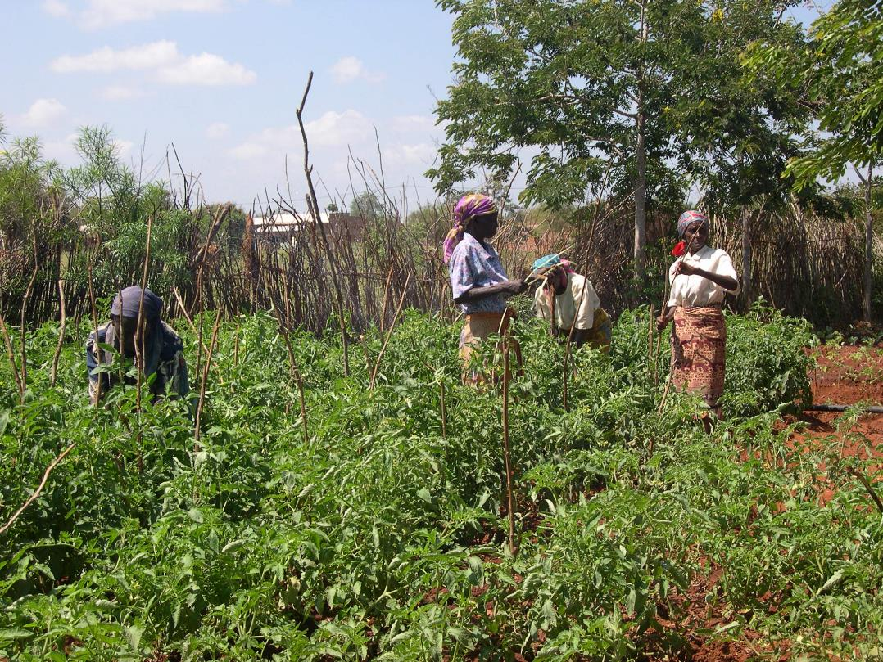
…provide sustainable farming feeds communities.

Slide 21
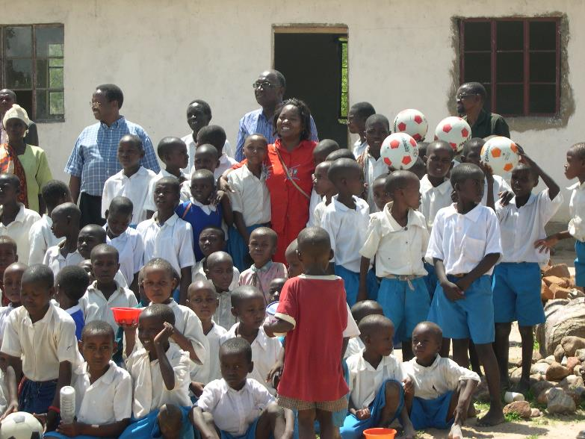
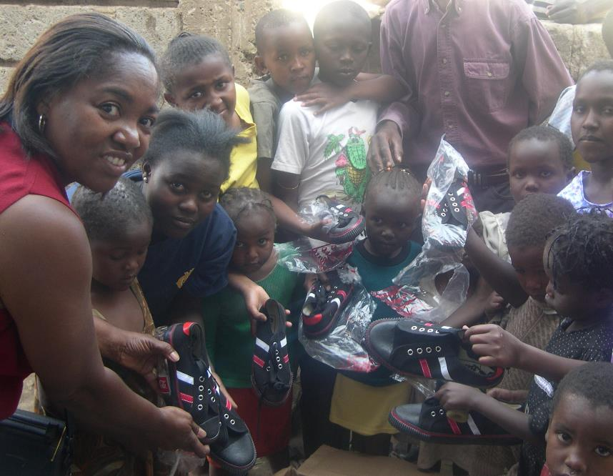
To build schools… provide food, clothing and shoes.

Slide 22
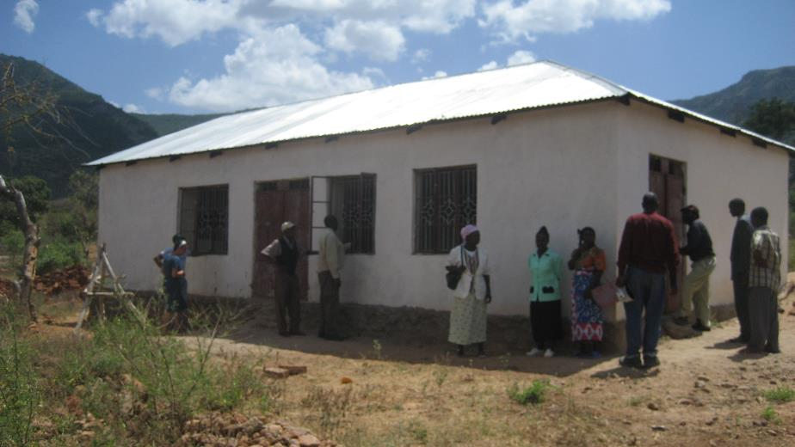
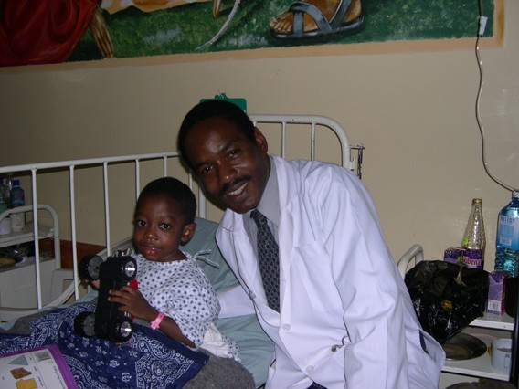
To build clinics, and provide care

Slide 23
God was happy…and took a day off!
Genesis 1:31 And God saw everything that he had made, and behold, it was very good. And the evening and the morning were the sixth day.

Slide 24
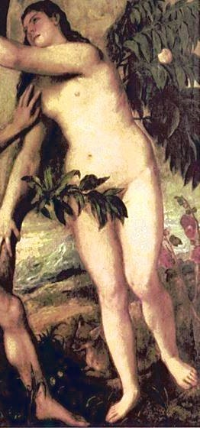
One day off only and another conversation started!
Genesis 3:2
And the woman said unto the serpent, We may eat of the fruit of the trees of the garden:
Genesis 3:6 And when the woman saw that the tree was good for food, and that it was pleasant to the eyes, and a tree to be desired to make one wise, she took of the fruit thereof, and did eat, and gave also unto her husband with her; and he did eat.

Slide 25
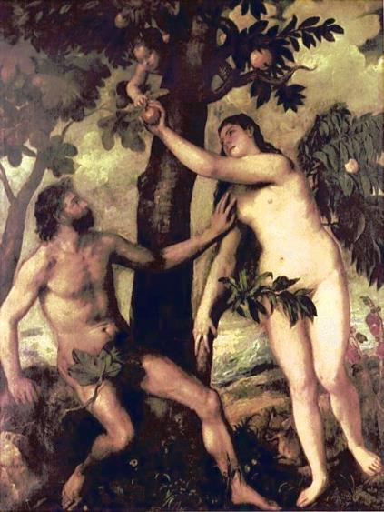

Then God became unhappy

Slide 26
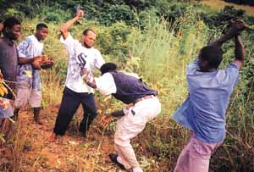
God was disappointed …, divinely dissatisfied!
Genesis 6:5 And GOD saw that the wickedness of man was great in the earth, and that every imagination of the thoughts of his heart was only evil continually.

Slide 27

God was divinely dissatisfied!
Genesis 6:6 And it repented the LORD that he had made man on the earth, and it grieved him at his heart.

Slide 28


There is a Devil wearing multiple disguises!
We have an unreal picture of evil and the devil…, we delight in both.

Slide 29
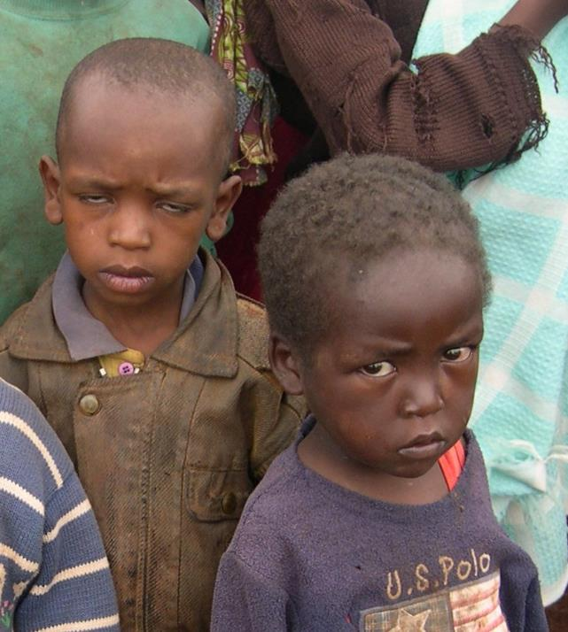
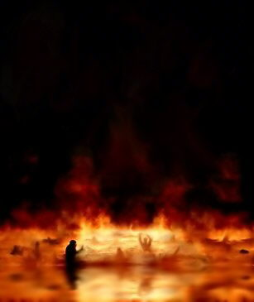
For most children in the world, that eternal torment…starts now!
Are these future evangelists, or future child soldiers, prostitutes, thugs and terrorists?
Should we tell them of heaven by-and-by and let them stay in hell right now?

Slide 30
We pray for God’s justice on our terms in our times
Acts 1:6 When they therefore were come together, they asked of him, saying, Lord, wilt thou at this time restore again the kingdom to Israel?
(A delay tactic of not going to get the job done. Try to change Jesus’ agenda! Another tactic would be, who is going to fry the chicken for the pastor’s anniversary? )
Acts 1:7And he said unto them, It is not for you to know the times or the seasons, which the Father hath put in his own power.
(Jesus redirects them. There is more to life than fried chicken the Lord says.)

Slide 31
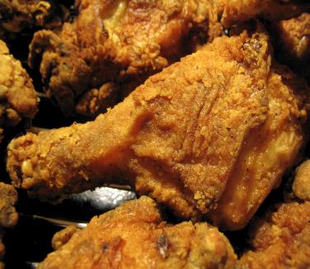
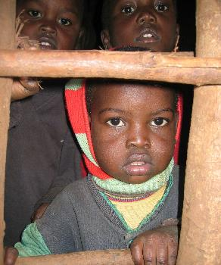
God has His own agenda and timing
Acts 1:8 But ye shall receive power, after that the Holy Ghost is come upon you: and ye shall be witnesses unto me both in Jerusalem, and in all Judaea, and in Samaria, and unto the uttermost part of the earth.
(Get up from the table and go out and win souls.)
≠

Slide 32

His own agenda and timing.
Galatians 4:4 But when the fullness of the time was come, God sent forth his Son, made of a woman, made under the law,

Slide 33
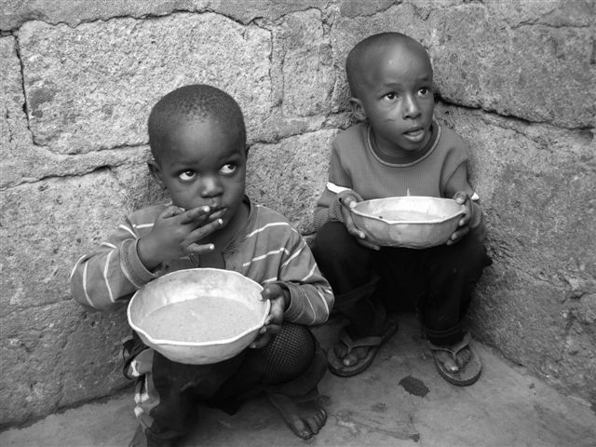
Divine Dissatisfaction
We have the luxury of discussing
  the millennial reign of Christ
  wars and rumors of wars
  famine
  disease

Slide 34
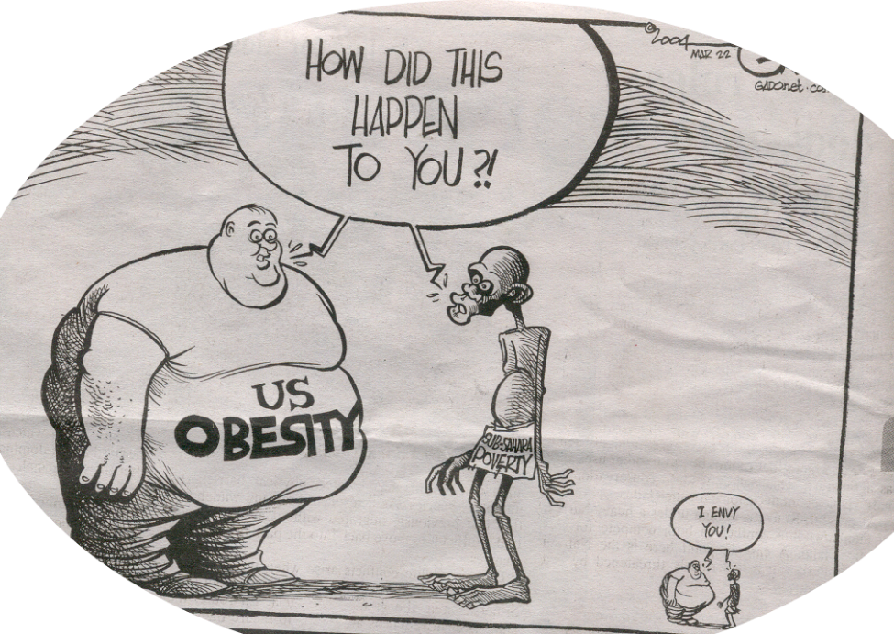
Divine Dissatisfaction
Most people are living this nightmare
as a daily diet…
if they can find food!

Slide 35
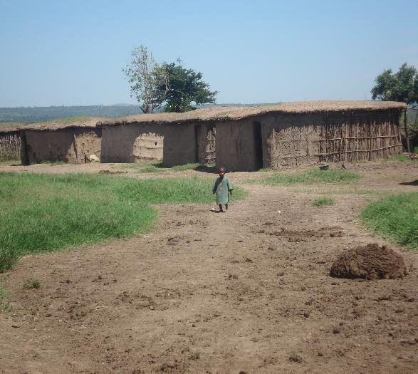
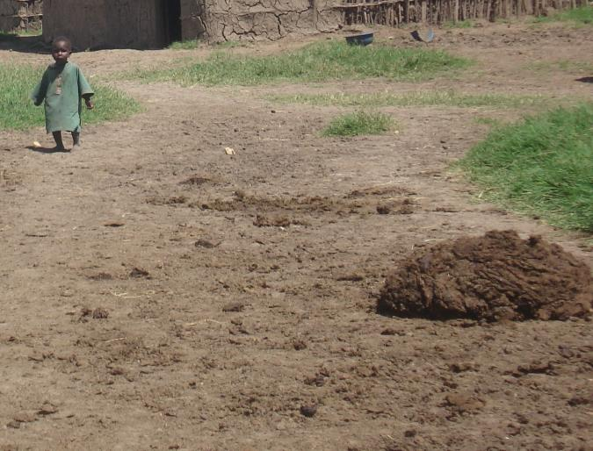
Why tell him about rumors of war and plague and famine…, and leave him living in dung?

Slide 36
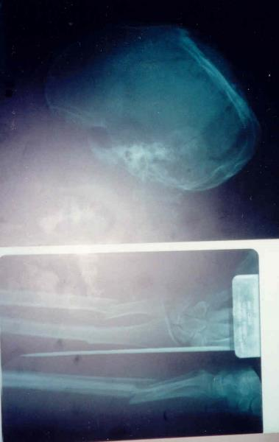
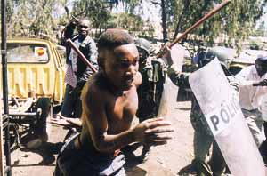
We have the luxury to pray for the end of times, instead of praying for the end of wars!
  Mt 24:14 And this gospel of the kingdom shall be preached in all the world for a witness unto all nations; and then shall the end come.

Slide 37
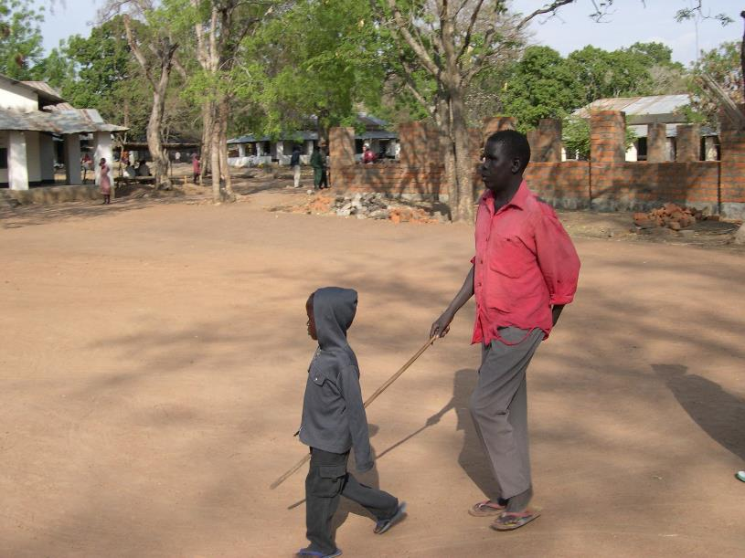
Blind man is totally dependent upon young child who is out of school
High levels of illness weaken a community.
  Little boy is not in school.
  Blind man can’t work.
  Neither of them can significantly contribute to their own survivability).
  If either dies, the other loses significance.
  What would Jesus do?

Slide 38
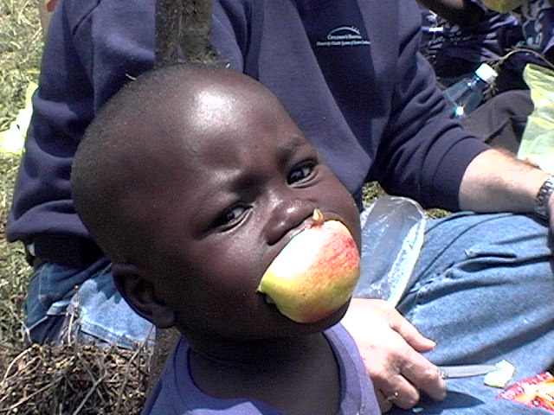
Divine Dissatisfaction
We pray for God’s kingdom to come, when it already has!
  Lu 17:21 Neither shall they say, Lo here! or, lo there! for, behold, the kingdom of God is within you.

Slide 39
We are to lose who we are, not celebrate it. We must become as He is!
The African American Church
  Escape from slavery
  Environment of safety
  Advocate of civil rights
  Dying / no missions except
  to self
Notes:
The African American Church
Born out of an escape from slavery
Nurtured in an environment of safety
Grew up as an advocate of civil rights
Dying without a clarion call for missions

Slide 40
Tradition is true, but not truth!
The European American Church
  Escape from religious intolerance
  The dominant culture
  White is might = right
  Dying /self righteousness dominant culture
Notes:
The European American Church
Born as an escape from religious intolerance
Nurtured as the dominant culture
Grew up as the white is might, hence right
Dying in a world of pluralism where no one recognizes its ‘righteousness’

Slide 41
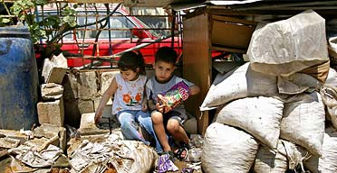
Reconcile to make Him known.
We are both (black and white) afraid of the ‘foreign invaders’, the new immigrants.
  Those people.
  We have all at one time been one of ‘those people’.
  We must reconcile.

Slide 42
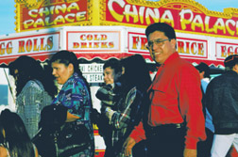
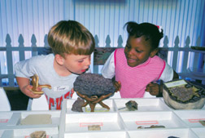

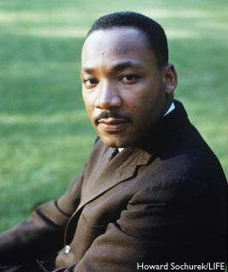
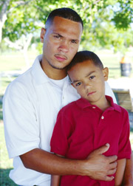

The core of the dream was not
equality, but reconciliation.

Slide 43
Divine Dissatisfaction
We have neglected to tell them about the Kingdom of Heaven…., we are too interested in our own kingdoms on earth.
AME
COGIC
NBC
ABC
PNBC
QRSTUVWXYZ
THE LIST GOES ON AND ON

Slide 44
We wear our Color as Coat of arms.
We have no moral superiority but a moral mandate.
Until the swords turn into plowshares,
Until the children eat their fill,
Until the mansions admit the lowly,
We have no cause for standing still.
    J. Small, 1990 (Australian Folk Singer)

Slide 45
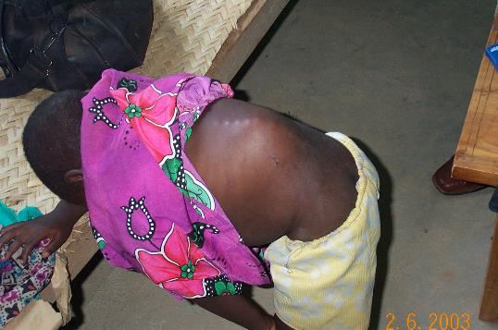
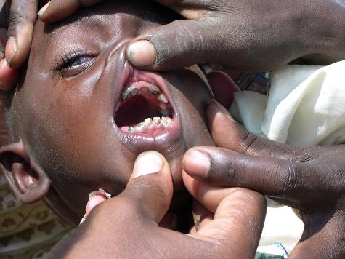
Divine Dissatisfaction
Lu 9:2 And he sent them to preach the kingdom of God, and to heal the sick
With TB of the spine, this child
would find it hard to look up at the
Savior.
How do we tell this toothless child
about the bread of life?

Slide 46

The Dilemma of our times is unique to us and does not resonate with most of the world!

Slide 47
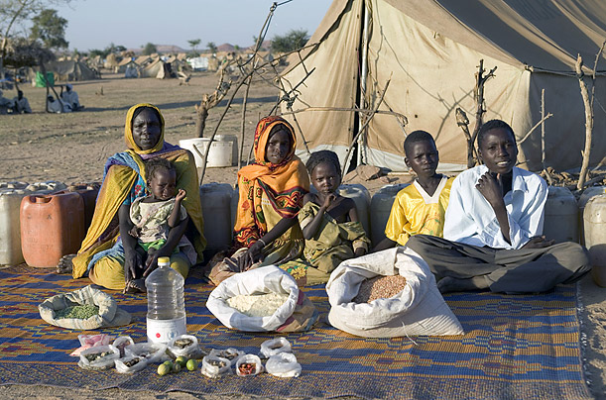
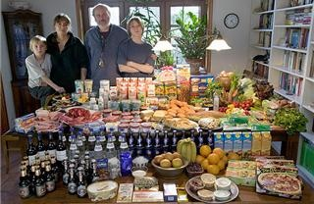
…, does not resonate…!
This family spends about $5 per week for food. When they can find it.
This family spends as much as they
want, whenever they want for whatever
they want.

Slide 48

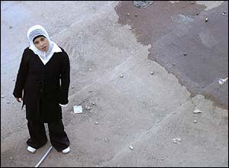
Divine Dissatisfaction
  We need to ‘find ourselves’ is what the preachers preach today. However, Jesus preached that we must lose ourselves!
  Mt 16:25 For whosoever will save his life shall lose it: and whosoever will lose his life for my sake shall find it.

Slide 49
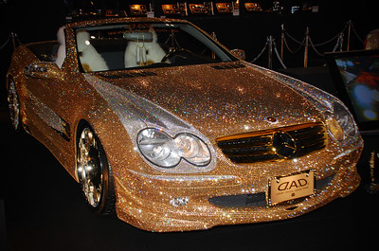
Divine Dissatisfaction
The god of prosperity.
Notes:
Leaders see what we have and they want the god we serve. The god of prosperity.

Slide 50
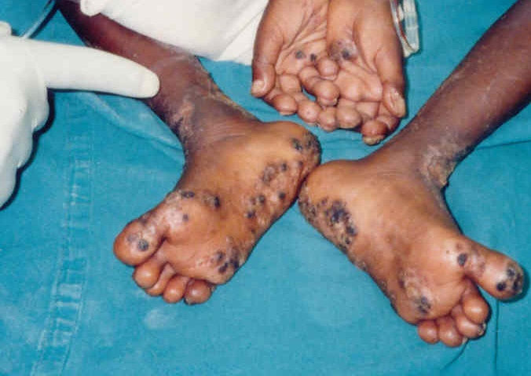
Here’s your change Jesus!
What did you do with the talents I gave you…, the Lord asked the servant.
That wicked servant replied…, ‘I had a party Lord.., and here’s your change!’

Slide 51
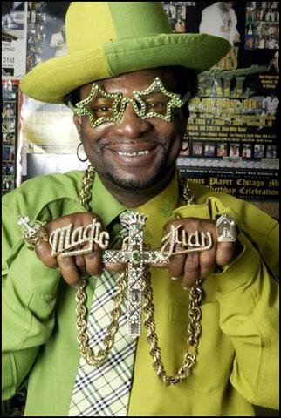
Access to Excess is Success?
Borrowing what we can’t afford to
collect things we don’t need and
can’t take with us when we die.
Is that an expensive cross he holds?
They used to give those away to
Christians of old.
Monetarily in debt.
Morally bankrupt!

Slide 52
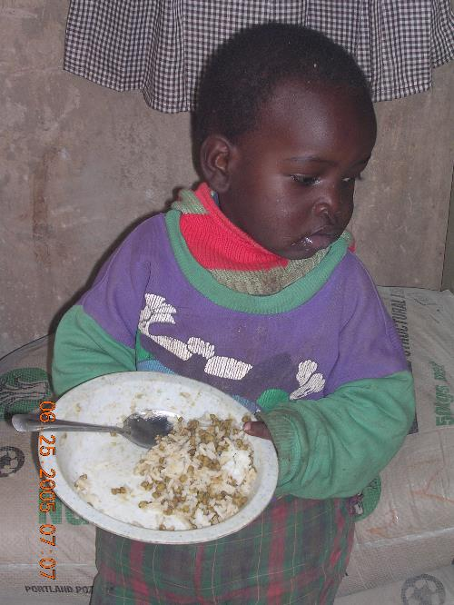
We enjoy our lifestyles to the exclusion of advancing the kingdom.
"I don't care what you favorite preaches says.
I'm giving you what the Lord says.
The Lord says to live life in abundance."
Rev. Creflo Dollar
Notes:
The Incarnational Church is careful not to replicate an idol of itself, which can neither be understood by the masses, nor sustained by its elite class.

Slide 53


God bless America is not in the Bible!
Pray for your enemies is in the Bible!
Mt 5:44
But I say unto you, Love your enemies, bless them that curse you, do good to them that hate you, and pray for them which despitefully use you, and persecute you;

Slide 54

The Lord declared.
  Jesus answered, My kingdom is not of this world John18:36

Slide 55
We must be discomforted.
We face an world that is increasingly:
  Hostile
      Terrorism/gangs/drugs/wars
  Skeptical
      Religious leaders who ravage and rape the sheep
  Confused
      Many forms of ‘Christianity’
  Hungry
      Desperate for spiritual and material nourishment

Slide 56

Go ye into all of the world…”
except where State Department advisories gang violence plagues unreceptive to the gospel.
Notes:
Our priorities will have to change if we really want to win the world for Christ.
Go ye into all of the world…, except where the State Department has advisories, or there is gang violence, plagues, or people unreceptive to the gospel. (Revised American full of Holes and Excuses 2006 edition: no cartoons or pictures included)

Slide 57

God is Dissatisfied.
His dissatisfaction is divine.
According to the World Christian Database, 419,429 missionaries globally are being sent from one country to another. Of these, 118,600 missionaries come from the USA.

Slide 58
Divine Dissatisfaction
If there are as many as 500 current African American cross-cultural missionaries from a population of 38,300,000 African Americans then African Americans are 0.4 percent of the total number of US missionaries, while being 12.7% of the US population.

Slide 59

AIDS
The Elephant in the room.

Slide 60

Mother Africa?
I’m glad I aint yo’ Momma!

Slide 61
Mother Africa?
I’m glad I aint yo’ Momma!
Sub-Saharan Africa needs less than 9 billion to fund all of the HIV AIDS programs for the next five years.
With the majority of the disease there, not a single manufacturer of the drugs is in Africa

Slide 62
9 billion for HIV/AIDS…,hmmm?!?
Pet spending
$17 billion in 1994 to an estimated $38.4 billion in 2006.
$15.2 billion for food
$9.3 billion for supplies and over-the-counter medications
$9.4 billion for veterinarian care
$1.8 billion for live animal purchases
$2.7 billion for other services
  US Dept. of Commerce

Slide 63

9 billion for HIV/AIDS…,hmmm?!?
“Today, chocolate seems to everywhere. In 2005, chocolate sales in the U.S. exceeded $3 billion.”
  New York Times Upfront, October 23, 2006:

Slide 64
Mother Africa?
I’m glad I aint yo’ Momma!
Just 25% of all the people in Africa who need the essential drugs
for this illness are receiving the drugs. This is an upsurge from a four years ago.

Slide 65
AIDS
The Elephant in the room.
70-80 babies per year in the US infected with HIV
630,000 babies per year in sub-Saharan Africa.
  (Audio-Digest Family Practice Sept 28, 2007)

Slide 66

AIDS in Africa
90% of the children orphaned by HIV/AIDS are in sub-Saharan Africa.
This epidemic leaves the very old and the very young behind. Neither
Is able to care for themselves. (WHO)
The young have no leadership and the
old are too tired to make a difference.

Slide 67

AIDS in Africa
Mother to child transmission is 25-45% unless the mother is treated with
Anti-retroviral medicines. Fewer than 10% of mothers in Africa receive these drugs. Corresponding values in America, and Europe are close to 80-100%
depending upon the country. Asia and Latin America have rates
from 10-50% (WHO)

Slide 68


AIDS in Africa/Progress
World Health Organization April 2007 progress report on AIDS/HIV in Africa shows
    1.3 million people on treatment (28% of those who need the medicine) which is a marked increase from 100,000 on treatment in 2004.

Slide 69
Short Term Missions Must Have Long Term Vision
We take a sick fish out of bad water and treat it and then put it right back in the bad water.
That is what short term medical trips do.
They must be developed long term visions.

Slide 70


Unless the dream is God’s it is no value!
THE DREAM IS BIGGER THAN THE DREAMER!
THE TRUE VISION BELONGS TO GOD NOT MAN.

Slide 71
Short Term Missions to develop
Long Term Visions
  HIV/AIDS
  4 million new HIV infections in 2006
  3 million deaths in 2006
  380,000 child deaths (under 15 years)
Water Borne Illnesses
  5 million children die per year
Malaria
  1.5 million deaths per year mostly children

Slide 72


Short Term Missions to develop
Long Term Visions
Without food and water…, AIDS drugs kill.
One child dies from bad water every 6 seconds…, most of these in Africa! Five million children per year!

Slide 73

Divine Dissatisfaction
To provide clean water to the world it would cost right around 9 billion dollars. That amount is what the U.S. spends in a year ON BOTTLED WATER!
From ProgressiveU.org a nonprofit social welfare organization

Slide 74

Check Please! Reality Check That Is!
We are content to have too much while
others have too little!

Slide 75
Check please! Reality Check Please!
In 2004 the estimated buying power of black households was $679 billion dollars.
Ghana sends 500 missionaries per year. Her population is 22.1 million and her Gross National Income is 10 billion.
African Americans spent 10.7 billion on household furnishings and equipment in 2004.
Nigeria sends 2500 missionaries per year and has a Gross National Income of 74.2 billion dollars.
African Americans spent this much on vehicles, insurance, clothing and gifts in 2004.

Slide 76
Detroit, which is 80% black, is the world's No. 1 market for Cognac.
Among our favorite purchases are cars and liquor.
Blacks make up only 12% of the U.S. population yet account for
30% of the country's Scotch consumption.
Source: Target Market

Slide 77
Check Please! Reality Check That Is!
Lincoln designed a limited-edition Navigator complete with six plasma screens, three DVD players and a Sony PlayStation2, because they were impressed with the $46.7 billion that blacks spent on cars
Sean "P Diddy" Combs, was the designer.
  Source: Target Market

Slide 78
Check please. Reality Check that is!
In 2002, the year the economy nose-dived; we spent
$22.9 billion ($22,900,000,000.00) on clothes,
$3.2 billion ($3,000,000,000.00) on electronics
$11.6 billion ($11,000,000,000.00) on furniture to put into homes that, in many cases, were rented.
$37.7 billion (37,700,000.00) Total
  Source: Target Market

Slide 79
Check Please! Reality Check That Is!
financial impediments
higher rates of unemployment,
income disparity and…
credit discrimination are financial impediments to the economic vitality of blacks, but…
so are our consumer tastes.
One easy solution
By finding the courage to change our spending habits, we might be surprised at how far the $631 Billion!
($631,000,000,000.00)
we now earn might take us.

Slide 80

Find the courage to change our spending habits?! You don’t mean it!

Slide 81
Check Please! Reality Check That Is!
Black Americans spend $772 per
consumer on entertainment. (US Dept. of Commerce)
In stark contrast, we spend a total of 22 cents yearly per
consumer in missions.

Slide 82

Missions is the Ministry of the Maladjusted
“You have allowed the material means by which you live to outdistance the spiritual ends for which you live. You have allowed your mentality to outrun your morality.”
-Dr. Martin Luther King Jr.

Slide 83
Missions is the Ministry of the Maladjusted
We have committed the sins of
  Self indulgence, isolation and ignorance
    Claiming the entitlement to borrow and spend
    Claiming the right to ignore and let others fix what is broken
  Self aggrandizement and Self pity
    Moral superiority because of our victim-hood

Slide 84

Missions is the Ministry of the Maladjusted
“I have the audacity to believe that peoples everywhere can have three meals a day for their bodies, education and culture for their minds, and dignity, equality and freedom for their spirits.”
-Dr. Martin Luther King Jr.

Slide 85


Missions is the Ministry of the Maladjusted
“I believe that what self-centered men have torn down, men other-centered can build up.”
  -Dr. Martin Luther King Jr.

Slide 86

Missions is the Ministry of the Maladjusted
Unless we are divinely disappointed, with the fact that people are living in extreme poverty, we will never get divinely dissatisfied.
If we are not discomforted
by the fact that this child will
and 40 others sleep on a bare
floor in a mud house.., we are
too comfortable with this world!

Slide 87

We move by our agenda, not God’s!
Mr 10:13 And they brought young children to him, that he should touch them: and his
disciples rebuked those that brought them.

Slide 88

God Divinely Delighted with His agenda!
Mark 10:14 But when Jesus saw it, he was much displeased, and said unto them, Suffer the little children to come unto me, and forbid them not: for of such is the kingdom of God.

Slide 89

The Gorilla in the room cannot be ignored!
Matthew 7:22-23
Many will say to me in that day, Lord, Lord, have we not prophesied in thy
name? and in thy name have cast out devils? and in thy name done many
wonderful works?
And then will I profess unto them, I never knew you: depart from me, ye
that work iniquity.

Slide 90
We’ll be held accountable!

Slide 91
No greater joy than being in His will.
Divinely Delightful!
Even Minnie A. agrees!

